Slide 1

Verlixir: Verification of Message-Passing Systems
Matt Neave

Slide 2
Why must we verify message-passing systems?
Recent rise in cloud-based clusters
Distributed systems are hard to reason about
Message-passing systems are a common implementation of IPC
Lots of research into the verification of sequential / shared-memory solutions
Lacking research into verification tooling for message passing for actor-based systems

Slide 3
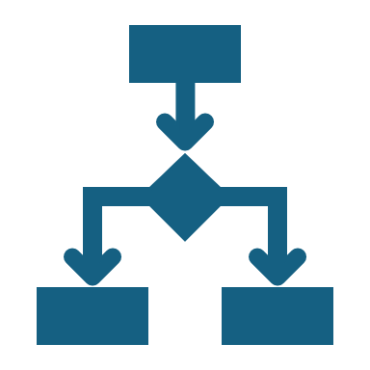
Concurrency
Multiple computations executed at same time
Threads / processes communicate with inter-process communication (IPC)
IPC typically achieved with shared memory or message passing

Slide 4
Actor Model
Model of computation where actors can:
Send messages to other actors
Spawn new actors
Act in response to a message

Slide 5
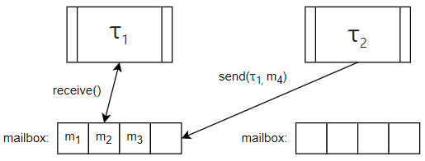
Actor Model

Slide 6

Elixir
Functional, concurrent, high-level programming language
Builds on top of Erlang – sharing abstractions for distribution and fault-tolerance

Slide 7
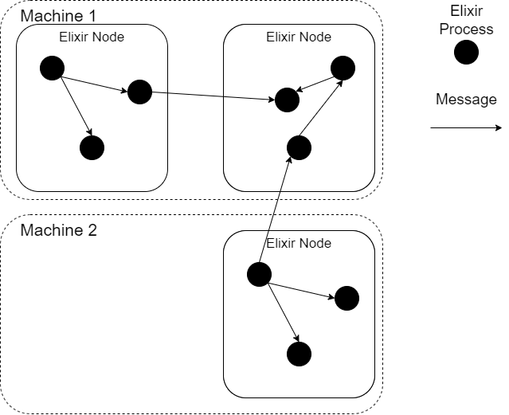
Elixir
# Spawn a new process
spawn(fn -> 1 + 2 end)
# Create a new BEAM instance Node.spawn(:"node1@localhost",
MyModule, :start, [])

Slide 8
Software Verification
Model Checking
Theorem Proving

Slide 9
Model Checking
Determining whether a model of system meets a specification
Typically, exhaustive search of all states (prone to state explosion)
Modern model checkers include Spin, PRISM, BLAST…

Slide 10
Verification-aware Languages
Programming language designed with built-in constructs to facilitate the verification of the program’s correctness
For example, Eiffel, Dafny
method sqrt(x: nat)
requires x >= 0
{
...
}

Slide 11
Why must we verify message-passing systems?
Recent rise in cloud-based clusters
Distributed systems are hard to reason about
Message-passing systems are a common implementation of IPC
Lots of research into the verification of sequential / shared-memory solutions
Lacking research into verification tooling for message passing for actor-based systems

Slide 12
Verlixir
Verification-aware programming language for message-passing systems
Supports the simulation and verification of systems in a safe, controlled environment
Provides a specification language with support for linear temporal formulae, predicates and design-by-contract-style functions
Allows concurrent properties to be parameterized and verified over multiple configurations

Slide 13
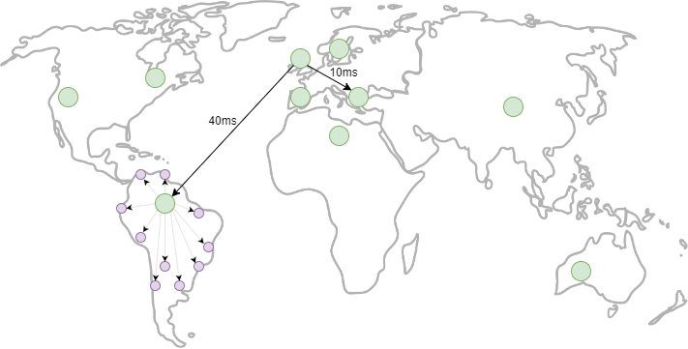
Verlixir Simulator

Slide 14
Verlixir Simulator
Entry point for Verlixir
defmodule Coordinator do
@init
@spec start_coordinator() :: :ok
def start_coordinator do
client_count = 100
server_count = 10
… spawn and link servers / clients …
end
end

Slide 15
Verlixir Simulator
./verlixir –s distributed_braodcast.ex
Starting global broadcast…
South-America broadcasting…
EU-South broadcasting…
…
All client acknowledgements received
Because of delays, real-world system may not observe this interleaving for hours / days / weeks…

Slide 16

Verlixir Verifier - Making Elixir Verification-aware
Deadlock and livelock detection, for FREE
Linear temporal logic (LTL) to reason about time and change
Design-by-Contract functions using pre- and post-conditions
Predicates

Slide 17
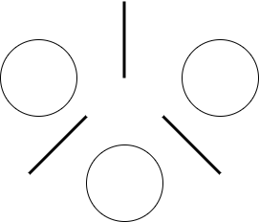
Verlixir Verifier: Deadlocks
Dining philosophers – classical deadlock problem
Philosophers need two forks to eat!

Slide 18
Verlixir Verifier: Deadlocks
Dining philosophers – classical deadlock problem
Philosophers need two forks to eat!
Some simulations output:
Others output:
Picking up 1
Picking up 2
Picking up 2
Picking up 1
All philosophers have finished eating!
Picking up 1
Picking up 2
Picking up 1
Picking up 2
timeout

Slide 19
Verlixir Verifier: Counterexamples
Verlixir verification mode produces counterexample!
verlixir –v dining_philosophers.ex
Model ran successfully. 1 error(s) found.
The program likely reached a deadlock. Generating trace.
(proc_1 - fork_loop) recv [PICKUP, phil1]
(proc_1 – fork_loop) send [ACK, phil1]
(proc_2 – fork_loop) recv [PICKUP, phil2]
(proc_2 – fork_loop) send [ACK, phil2]
(proc_2 – fork_loop) recv [PICKUP, phil1]
(proc_1 – fork_loop) recv [PICKUP, phil2]
timeout
Both forks have been picked up!

Slide 20
Verlixir Verifier: LTL
Same as deadlock counterexamples, Verlixir will produce counterexamples violating LTL formula
defmodule Atm do
@ltl """
<>(card_inserted)
[](card_inserted->(<>[](transaction_failed)||<>[](atm_balance<1000)))
"""
def start_atm do
atm_balance = 1000
card_inserted = false
transaction_failed = false
... implementation ...
do
end

Slide 21
Verlixir Verifier: contracts
Introduce pre- and post-conditions with Verlixir contract
defv add(x, y), pre: x > 0 && y > 0, post: z == x + y do
... defines z somehow ...
end
`defv` introduces a contract

Slide 22
Verlixir: predicates
Simplify LTL claim readability
Used as expression conditions
@ltl "[](new_round -> <>(consensus)"
def run do
predicate new_round, messages_received == 0 && messages_sent == 0
predicate consensus, messages_received >= number_of_nodes / 2 + 1
...
if new_round do
...
end
end

Slide 23
Verlixir Verifier: concurrency parameterisation
Model different configurations of variables
@model {:client_count, :server_count}
def start_coordinator do
client_count = 100
server_count = 10
… spawn and link servers / clients …
end

Slide 24
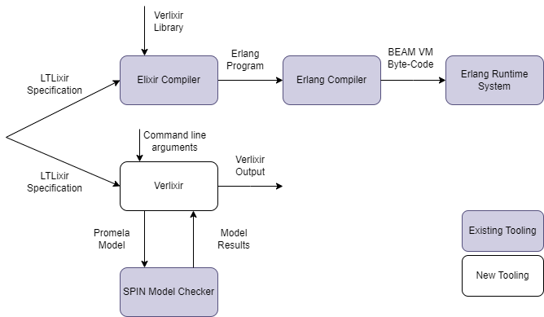
High-level Overview

Slide 25
Verlixir System
Extend Elixir with Metaprogramming
Extract Elixir AST
Map Elixir AST into intermediate representation (IR)
Generate a Promela model from IR
Run model with Spin model checker
Map counterexample back to Elixir format

Slide 26
Evaluated algorithms
Basic Paxos
Consistent hash ring
Dining philosophers
Two-phase commit
Raft (leader election)

Slide 27
Future Work
Fault injection – determine if systems are fault tolerant by killing processes during verification
Computation-tree logic (CTL) support, i.e. for algorithms like Raft, where leader election is not guaranteed, we can determine there exists a path where a leader is elected

Slide 28
Final Remarks
Specifying systems in terms of safety and liveness should be apart of all software development
Verification-aware languages make system specification more accessible to developers
With rise of generative AI, we could move towards automatic system implementation from well formed system properties – the use of verification-aware languages can form a feedback loop to ensure the system correctness

Slide 29

Questions?

